Slide 1
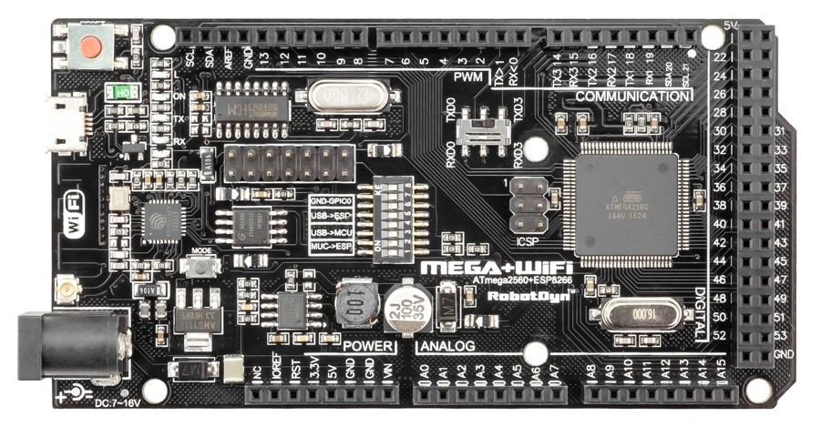
How to setup Arduino Mega + Wifi R3

Slide 2

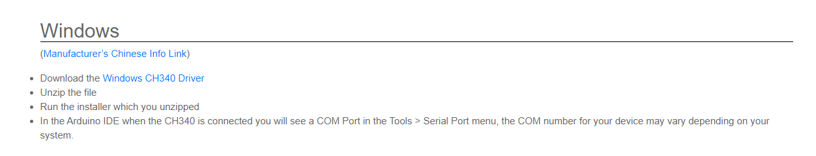
Step 1: Install driver ch340g usb
For detect port usb mega + wifi R3
Download link: https://sparks.gogo.co.nz/ch340.html
Click here

Slide 3
Step 2: Flash esp8266
Upgrade firmware system in esp8266
For Arduino mega communication with esp8266
Esp8266

Slide 4
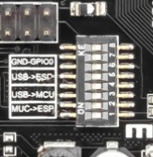
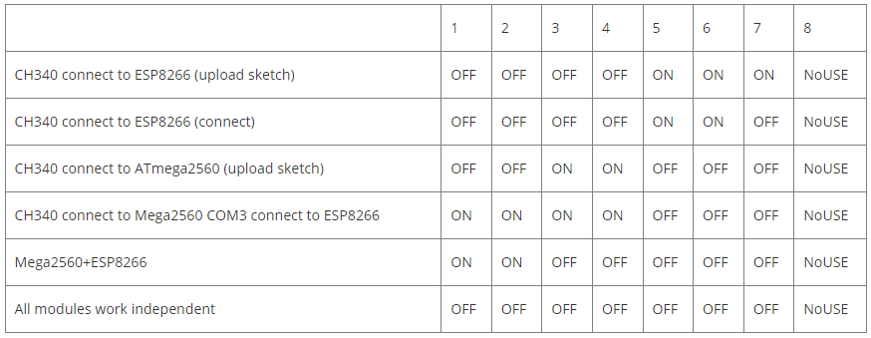
Set two switch for flash firmware
Change switch ch340 connect to ESP8266 (upload sketch).

Slide 5
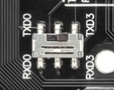
Change switch txD0 and rxD0

Slide 6
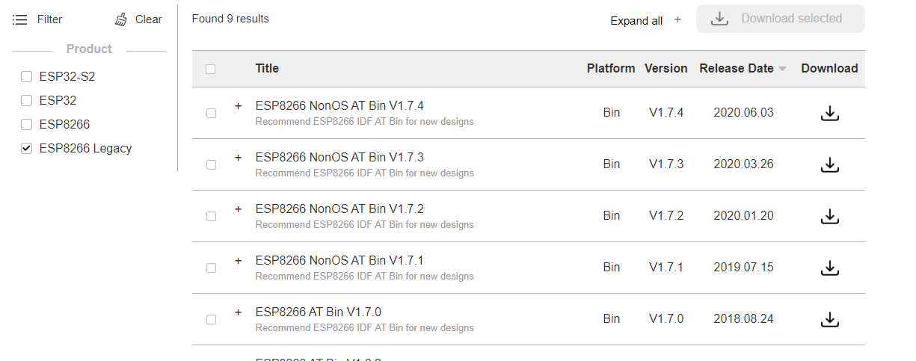
Download file firmware and tool for flash esp8266
Download link for firmware : https://www.espressif.com/en/support/download/at
Download link for tool : https://www.espressif.com/en/support/download/other-tools
Tick esp8266 legacy

Slide 7
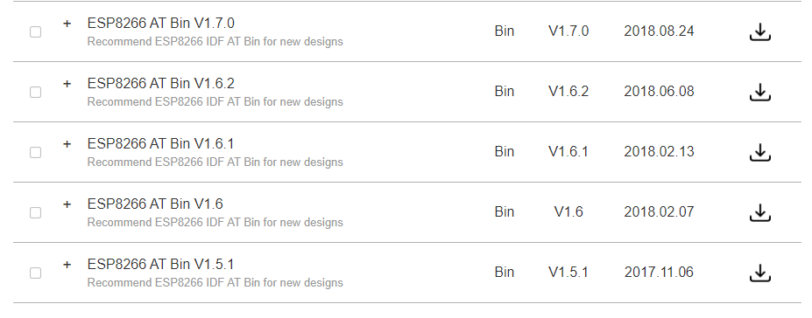
Download ESP8266 AT Bin not ESP8266 NonOS AT Bin. Can download any version or new version to come.

Slide 8
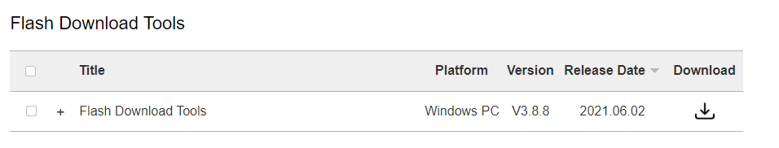
Download flash tools

Slide 9
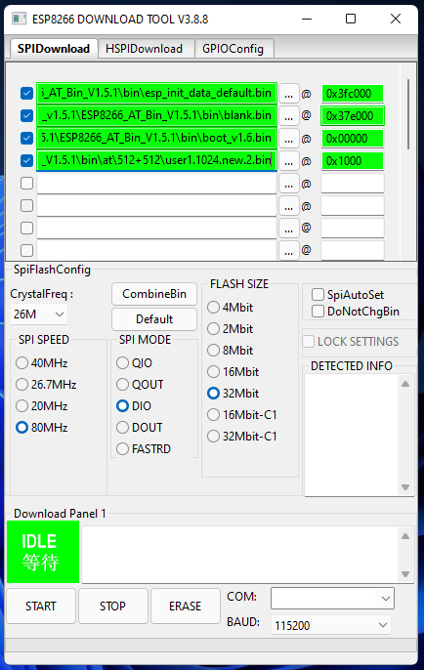
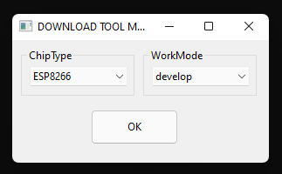
Extract 2 file firmware and tool
Open tool select esp8266 and develop then ok
SET ADDRESS
Esp_init_data_default : 0x3fc000
Blank : 0x37e000
Boot_v1.2 or v1.6 or v1.7 : 0x00000
User1.1024.new.2 : 0x1000
Set tool SPIDownload and insect a file with an image
Set spi speed 80MHz, spi mode DIO, flash size 32bit and untick donotchgbin
Enter cable usb Arduino then set com auto detect and baudrate 115200
Last go start and wait finish.

Slide 10
Step 3: Test At Command Esp8266 with Serial
Set switch ch340 connect to ESP8266 (connect)
Set switch rxD0 and txD0

Slide 11
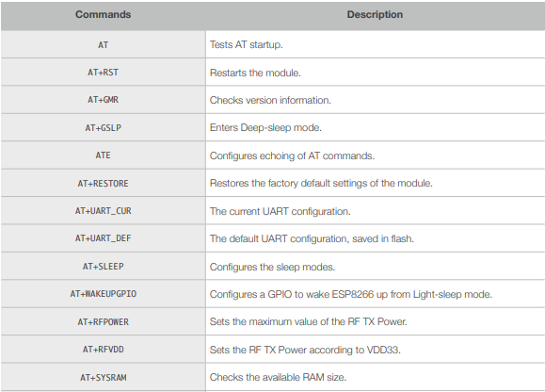
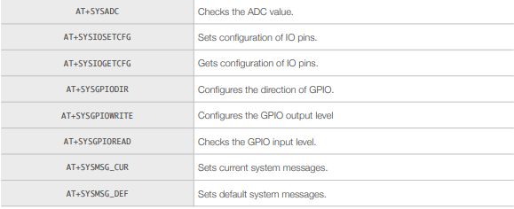
Open software Arduino and set port then open serial monitor
Set baudrate 115200 and bolt NT & CR

Slide 12
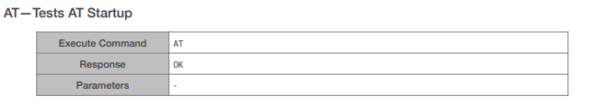
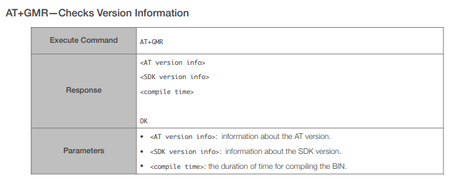
Send AT
Send AT+GMR

Slide 13
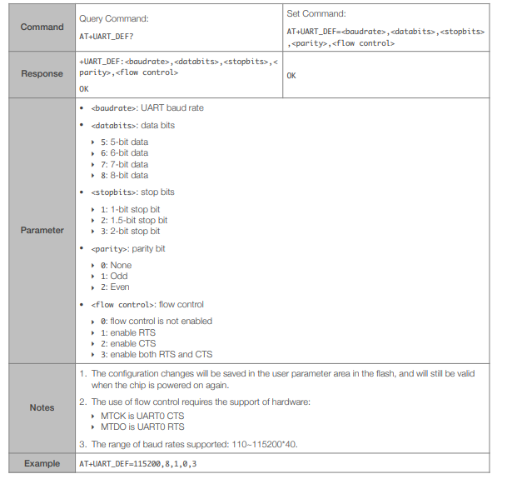
Change baud rate to 9600
Send AT+UART_DEF=9600,8,1,0,0
After change baudrate, change baudrate at Serial monitor 9600 and test AT again.
If respond ok finish.

Slide 14
Step 4 : Arduino mega connect with esp8266
Set switch ch340 connect to mega2560 com3 connect to esp8266
Set switch rxD3 and txD3

Slide 15
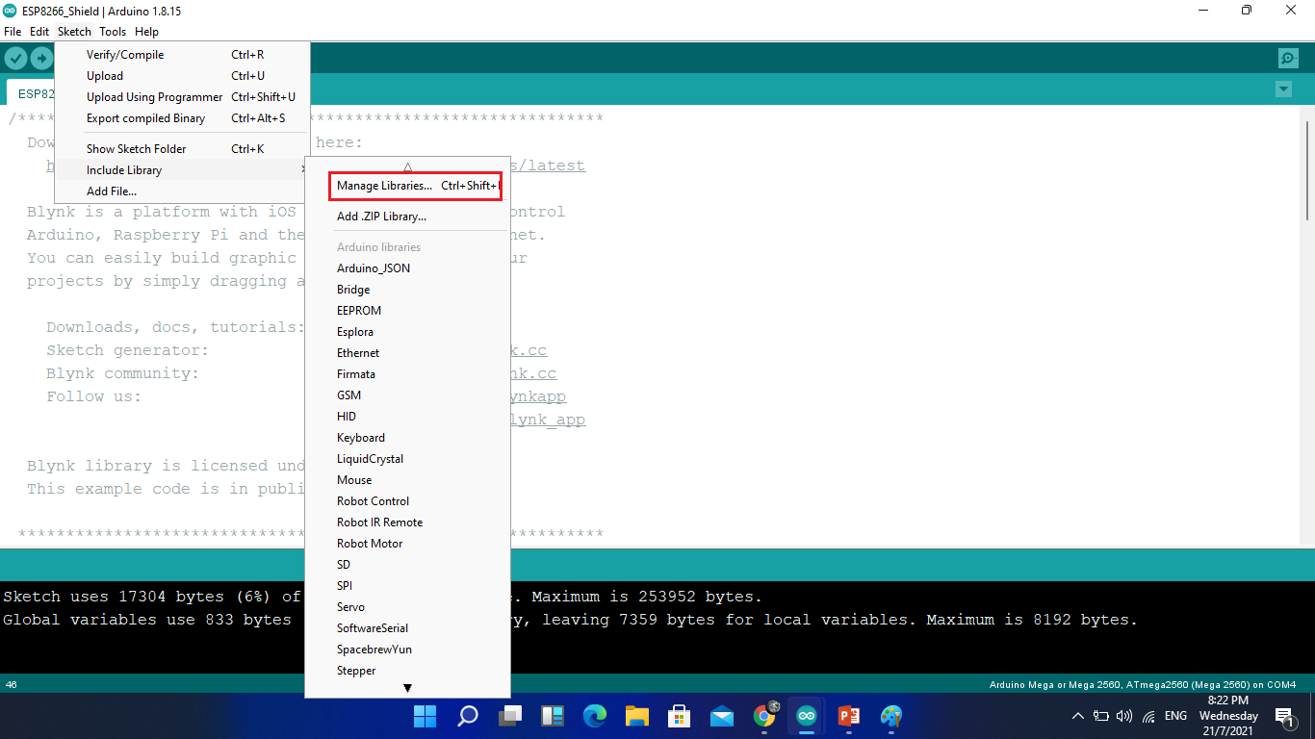
Test esp8266 with server blynk
Download library blynk new version or old version at manager libraries
Can tap cltl+shift+I
for open manager
libraries

Slide 16
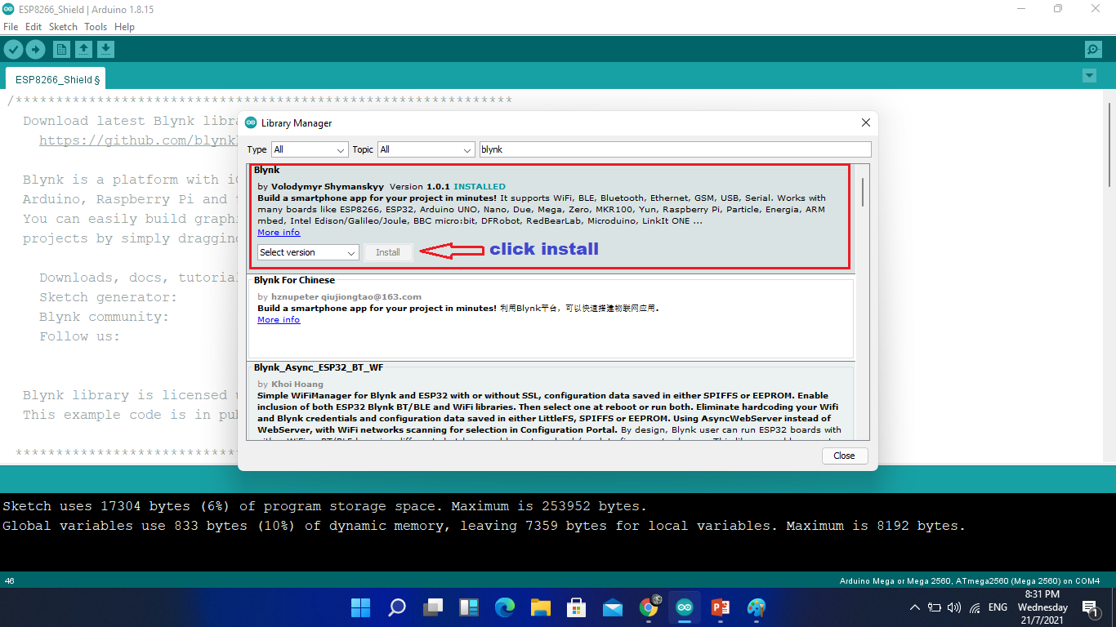
Write blynk and install library blynk

Slide 17
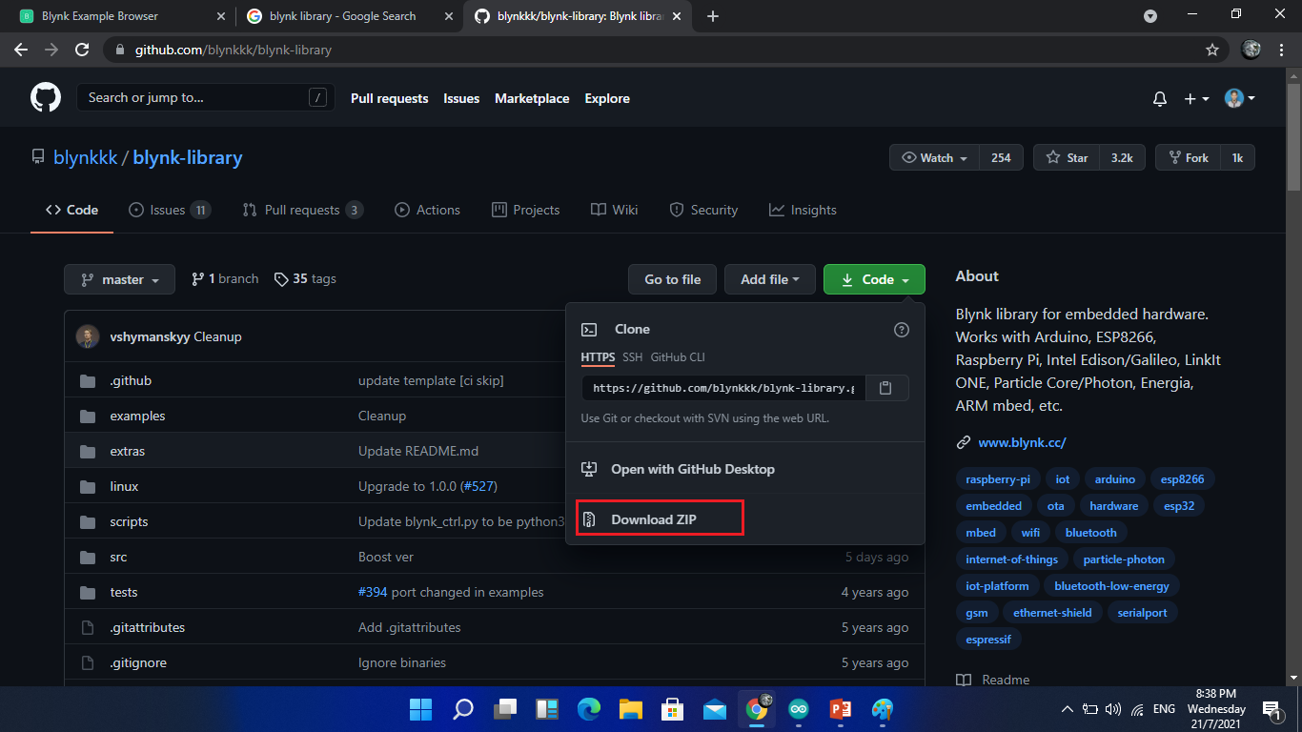
Can download manual and install manual library blynk
Download link : https://github.com/blynkkk/blynk-library

Slide 18
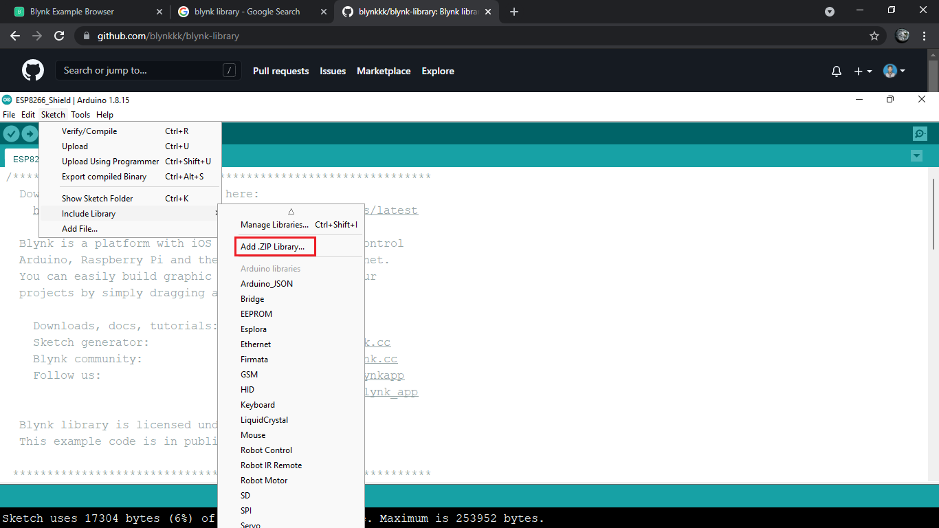
Add library in software Arduino manual
Click add .zip library then add file blynk download

Slide 19
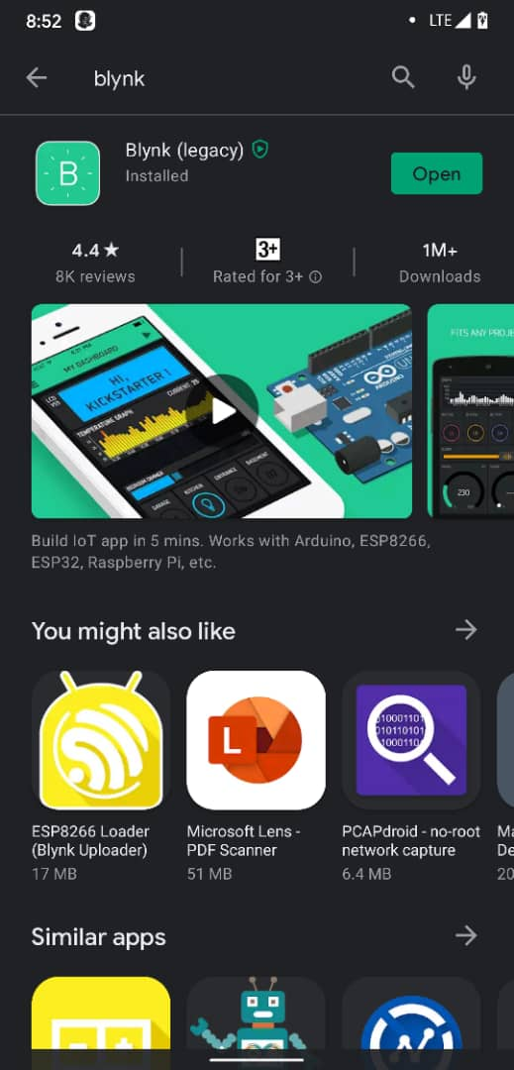
Download apps blynk and setup apps blynk
Download apps blynk at play store for android or App store for ios
Sign up blynk

Slide 20
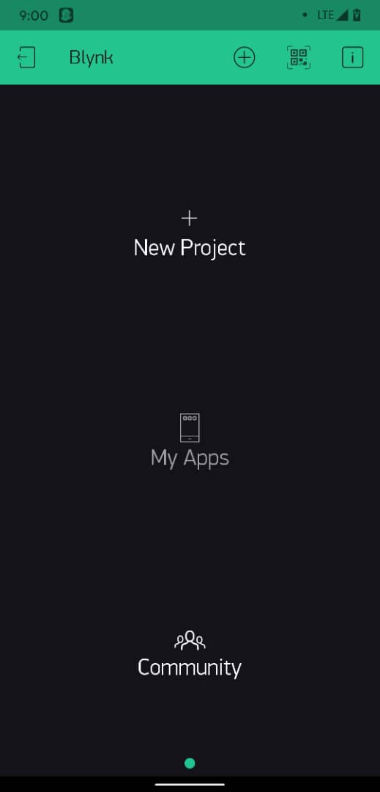
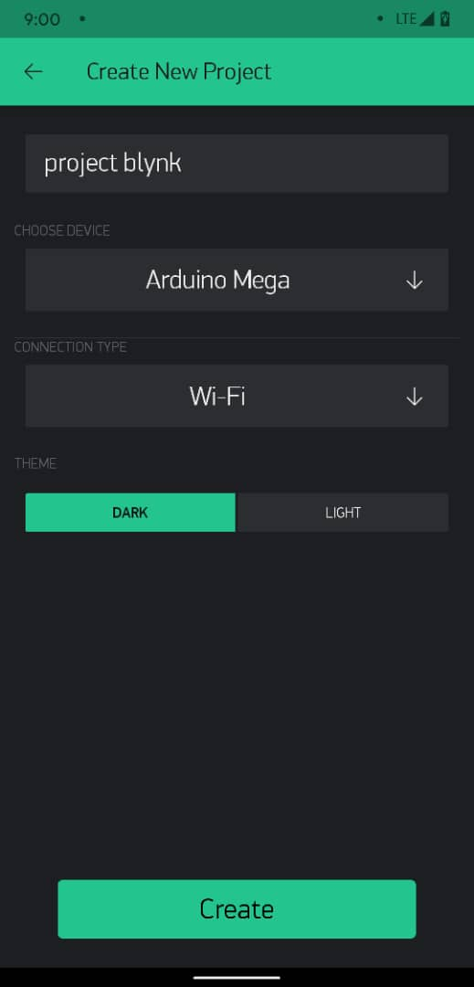
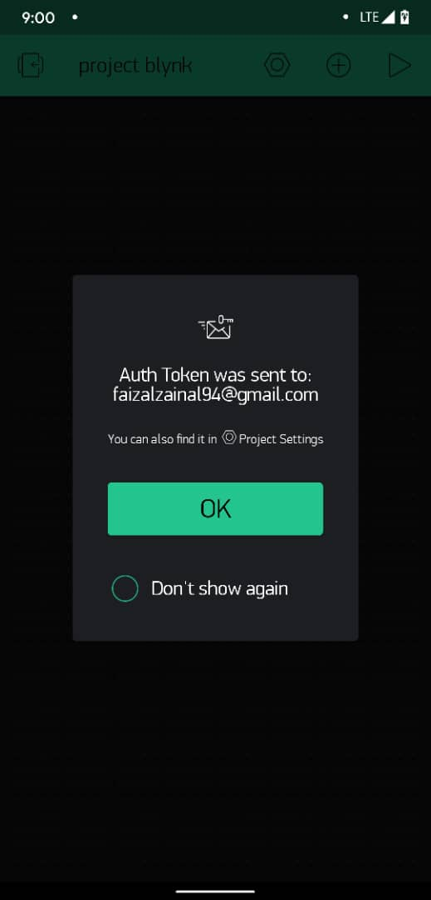
Create new project
Enter your project name, choose device Arduino mega and connection type wi-fi then create
Open your email for blynk token

Slide 21
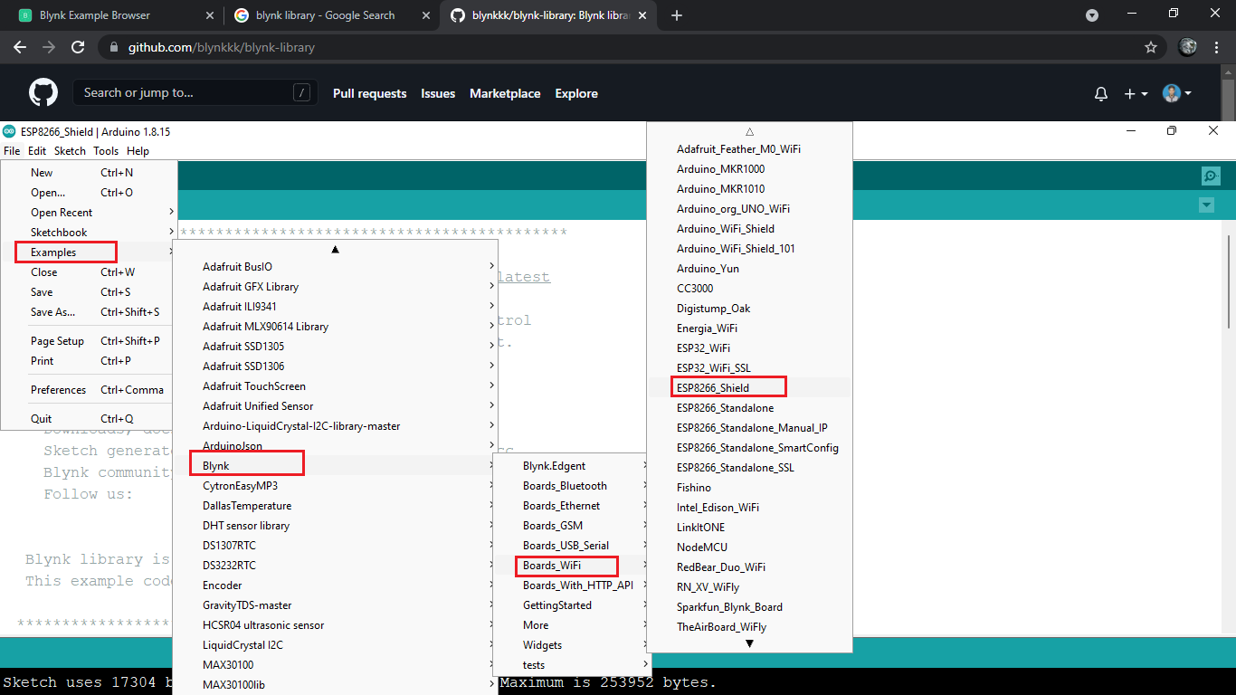
Coding for blynk
Open example code in library blynk

Slide 22
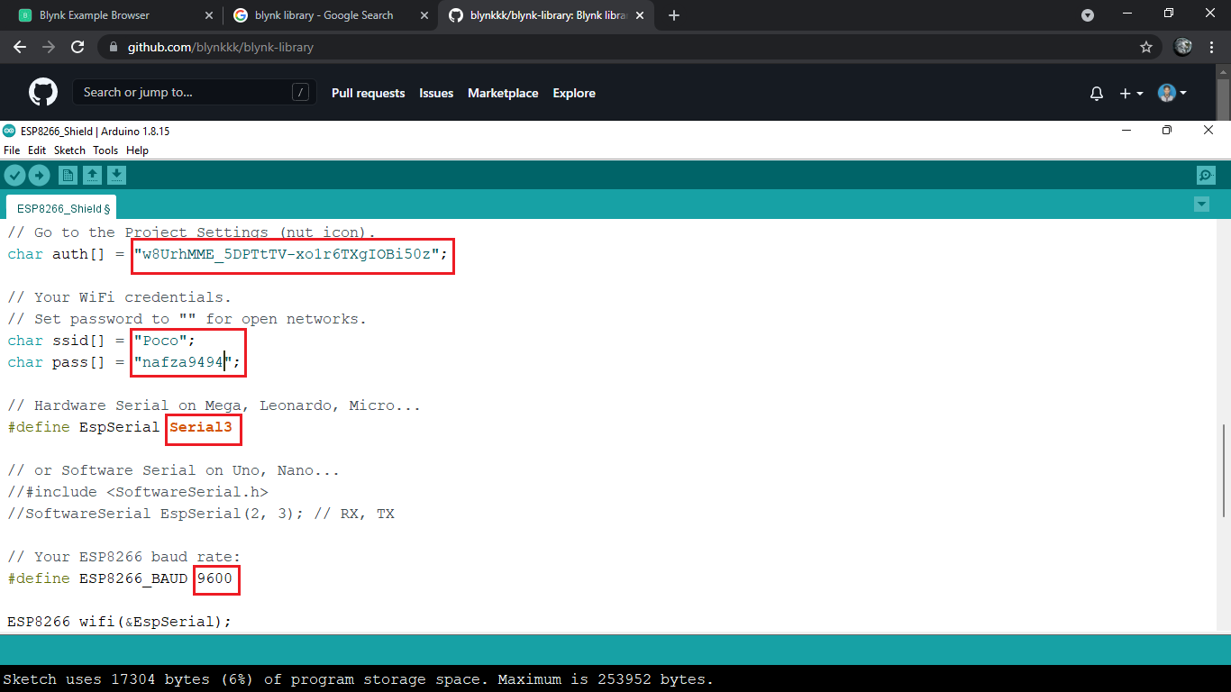
Change your token
Enter your Wi-Fi name and password Wi-Fi
Change serial1 to serial3
Change baud rate 9600

Slide 23
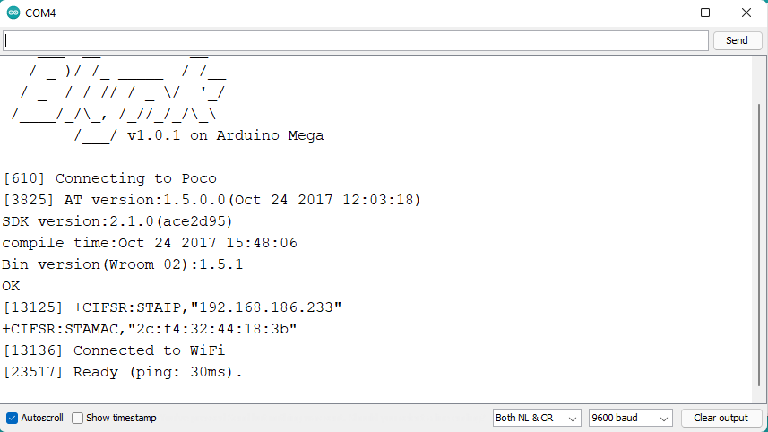
Verify code and upload code
Finish upload open serial monitor for make sure esp8266 connect with server blynk and ready

Slide 24
Test esp8266 with API server
Download library WifiEsp or WifiEspAT
Download link : https://github.com/bportaluri/WiFiEsp
or : https://github.com/jandrassy/WiFiEspAT
Add library in software Arduino

Slide 25
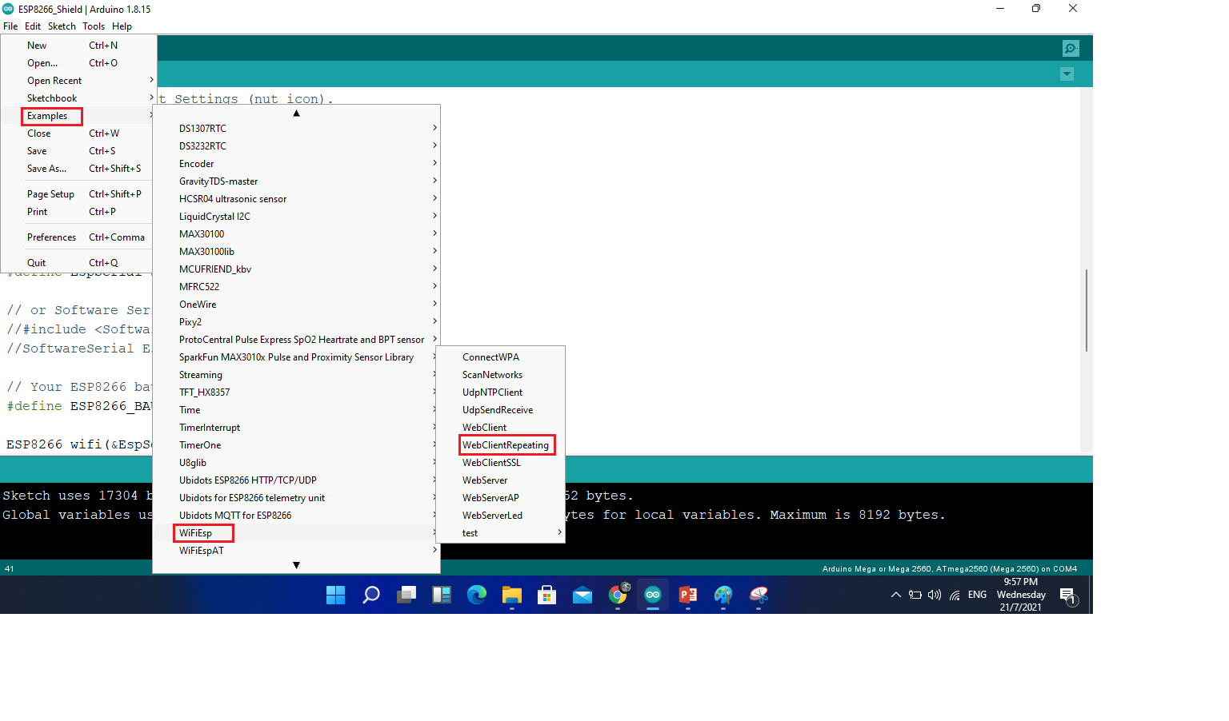
Open example wifiEsp webclientRepeating

Slide 26
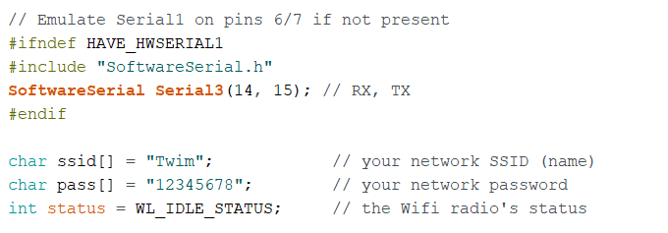
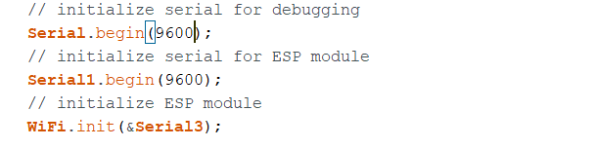
Change serial3 pin RX and TX 14 and 15
Enter Wi-Fi name and Wi-Fi password
Change baud rate 9600

Slide 27
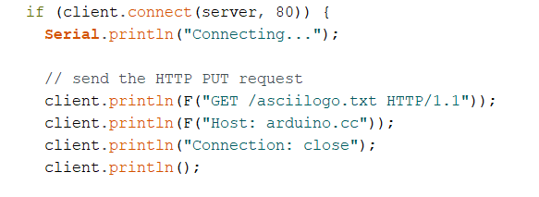
Can GET, POST, PUT, GET request and POST request data
Change link
Can connect with SSL or no SSL with change port 80 for no SSL or port 443 for SSL

Slide 28
Example get Api server thingspeak
https://thingspeak.com
Sign up thingspeak
Create project
Go API keys then can use write and read link for get data

Slide 29

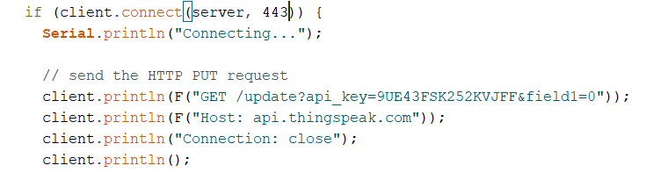
Example : https://api.thingspeak.com/update?api_key=9UE43FSK252KVJFF&field1=0link
Change server api, port 443 because https is SSL and link get data
Can send data with change field1 = with your data in String data
Verify coding and upload

